Slide 1


Slide 2

Welcome to
BZFLS
HSC Program
“Supported to Succeed, Accountable to Grow.”

Slide 3
BZFLS - HSC Program
Year 12 – Week 42
Year 11 – Week 28
Year 10 – Week 6
2

Slide 4
Year 10 Pre-HSC
Week 6
Assessment Schedule
Assessment 1- 30% (Week 7)
October 12-16

Slide 5
Year 11 Preliminary
Week 28
Important Dates
October 10 – Year 11 Parents & Teachers
Meeting
October 12 – New Year 12 Begins

Slide 6
Year 12 HSC
Week 42
Friday Afternoon Revision Schedule
October 10 – EALD
October 16 – Chinese & Literature (CAL)
Sunday Night Study Revision Schedule
October 11 – EALD
October 18 – Mathematics Advanced (MAD)

Slide 7
Year 12 HSC
WEEK 42
External Exam Schedule
October 13-14 – EALD
October 19 – Mathematics Advanced
October 21 – Chinese & Literature
October 23 – Mathematics Extension 1
October 26 – Business Studies
October 30 – Visual Arts
November 5 - Physics

Slide 8
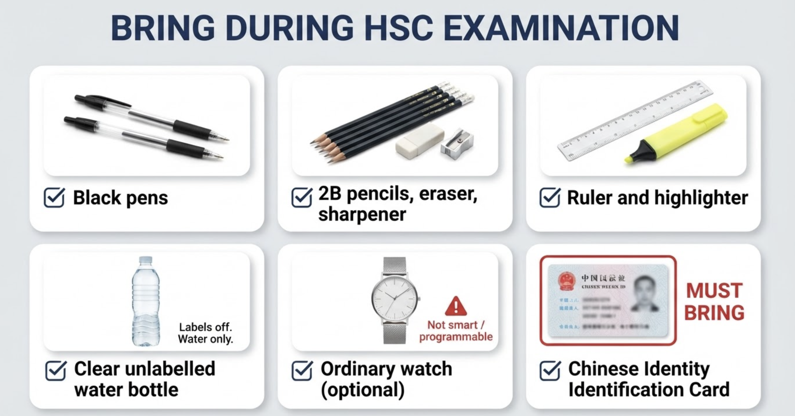

Slide 9


Slide 10


Slide 11


Slide 12


Slide 13


Slide 14
Year 12s,
The finish line is in sight. This is your time.
Don't waste a single day. You are capable. You are prepared. You are ready.
Your teachers support you. Your family cheers for you. But the effort must come from you.
We believe in you.
Now go – show what you can do.

Slide 15



Slide 16
“
We do everything we can,
to help you succeed.

Slide 17


